Slide 1
R Programming Course
4. Graphs

Slide 2

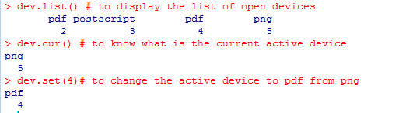

R Programming Course
4.1 Graphical devices
When a graphical function is executed, R opens a graphical window (X11 for windows) and displays the graphic.
A graphical device will open with a function depending on the format:postscript(), pt(), pdf(), png().
The list of available graphical devices can be found with ? Device.

Slide 3
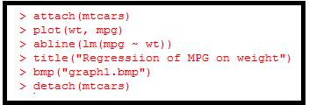
R Programming Course
4.1 Graphical devices - continued
You can save the graph via code using one of the following functions:
Function | Output to
pdf(“graph1.pdf”) | pdf file
win.metafile(“graph1.wmf”) | windows meta file
png(“graph1.png”) | png file
jpeg(“graph1.jpg”) | jpeg file
bmp(“graph1.bmp”) | bmp file
postscript(“graph1.ps”) | postscript file

Slide 4
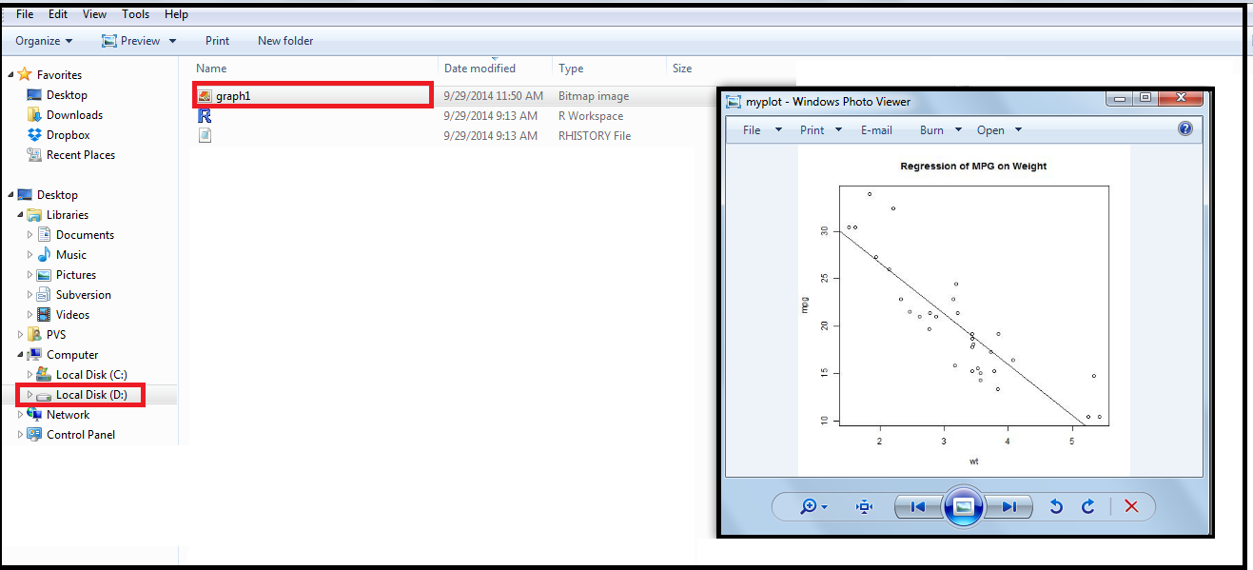
R Programming Course
4.1 Graphical devices - continued

Slide 5
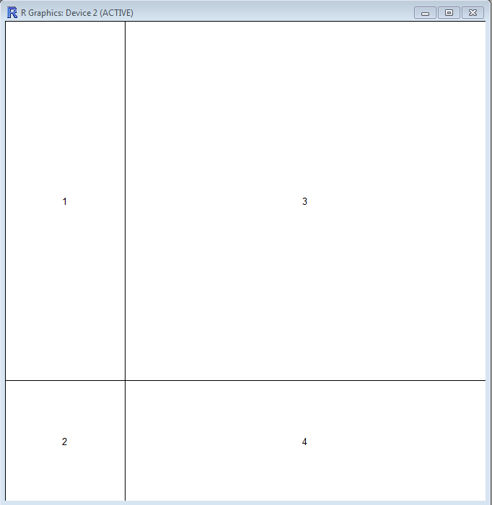

R Programming Course
4.2 Partitioning a graphic
The function layout partitions the active graphic window in several parts where the graphs will be displayed successively.
To actually visualize the partition created, one can use the function layout.show with the number of sub-windows as argument.
By default, layout() partitions the device with regular heights and widths: this can be modified with the options widths and heights.
These dimensions are given relatively.

Slide 6
R Programming Course
4.3 High-level commands
Built-in functions in R help us to make plots as per the requirement.
Powerful plotting techniques make R an important tool for statistical applications. High-level commands endue creating new plots with fundamental information like axes, title, labels etc.
plot(): This is the most frequently used plotting command in R. It is a generic function which creates plots of type equivalent to that of the first argument.
In the example below, vector data is plotted which is given as the first argument to the plot function.

Slide 7
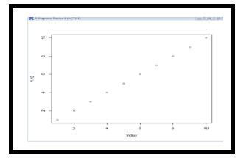
R Programming Course
4.3 High-level commands - continued
R provides various high-level plotting functions to create variety of plots including boxplot, pie chart, barplot, and histogram.
Function | Description
plot(x,y) | Bivariate plot of x (on the x-axis) and y (on the y-axis)
boxplot(x) | Box-and whiskers plot
pie(x) | Circular pie chart
barplot(x) | Histogram of the values of x
hist(x) | Histogram of the frequencies of x

Slide 8
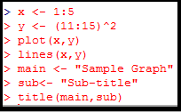
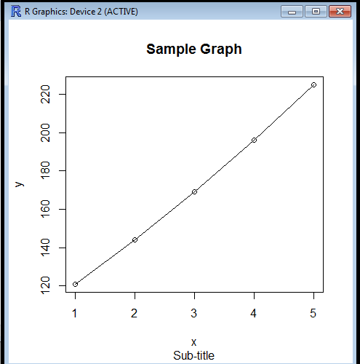
R Programming Course
4.4 Low-level commands
Low-level commands enhance existing plots with features like extra points, labels etc.
These commands require coordinate positions also, to indicate the position where we have to insert the new plotting elements.

Slide 9
R Programming Course
4.4 Low-level commands
Some of the low-level plotting commands are listed in the below table.
Function | Description
points (x,y) | Add points to the current plot
lines (x,y) | Add connecting lines to the current plot
text (x,y, labels, …) | Add text to the plot at point x and y. Lables is a vector in which labels[i] is at the point (x[i],y[i])
abline (a,b) | Adds a line of slope b and intercept a to the current plot
polygon (x, y,..) | Draws a polygon defined by the vertices (x,y)

Slide 10
R Programming Course
4.4 Low-level commands
legend (x,y, legend, fill=…) | Adds a legend to the current plot at the specified position. fill if specified, this argument will cause boxes filled with the specified colors (or shaded in the specified colors) to appear beside the legend text.
title (main, sub) | Adds a title main to the top of the current plot in a large font and (optionally) a sub-title sub at the bottom in a smaller font
axis (slide) | Adds an axis to the current plot on the slide given by the first argument

Slide 11
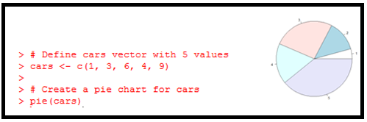
R Programming Course
4.5 Some graphs – Pie chart
A circle graph or pie chart is a way of summarizing a set of categorical data or displaying the different values of a given variable (e.g., percentage distribution).
This type of chart is a circle divided into a set of series of segments. Each segment represents a particular category. The area of the segment is the same proportion of the circle as the category is of the total data set.

Slide 12
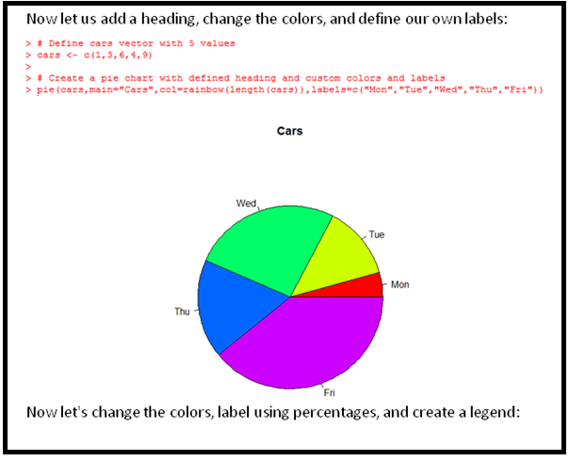
R Programming Course
4.5 Some graphs - continued

Slide 13
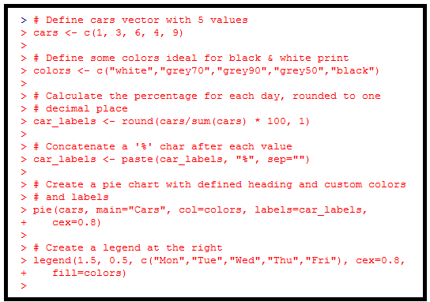
R Programming Course
4.5 Some graphs - continued

Slide 14
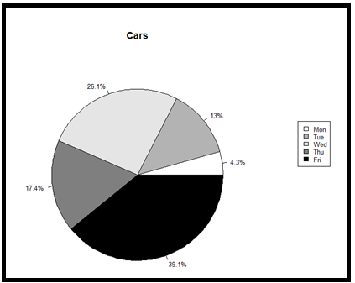
R Programming Course
4.5 Some graphs - continued

Slide 15

R Programming Course
4.6 Base, Grid, and Lattice Graphics
Base graphics is the graphics system that was originally developed for R. The workhorse function of base graphics is a plot().
The code for base graphics is in the graphics package which is loaded by default when you start R.
Grid graphics is an alternative graphics system that was later added to R. The big difference between the grid and the original base graphics system is that grid allows for creation of multiple regions, called viewpoints, on a single graphics page.
Grid is a framework of code doesn't by itself create complete charts.
Lattice is a graphics system that specifically implements the idea of Trellis graphics (or faceted graphics), which was originally developed for the languages S and S-Plus at Bell Labs.
Lattice graphics in R makes use of grid graphics.

Slide 16
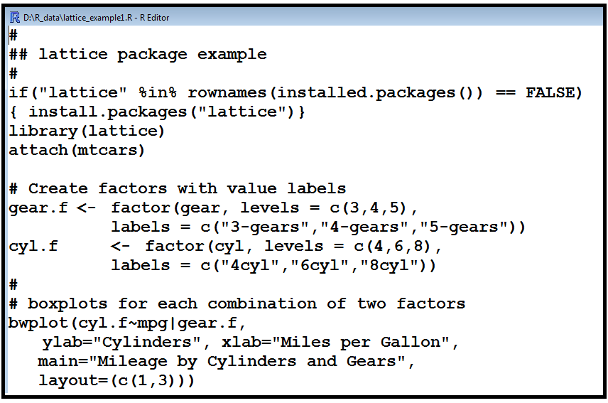
R Programming Course
4.6 Base, Grid & Lattice Graphics - continued

Slide 17
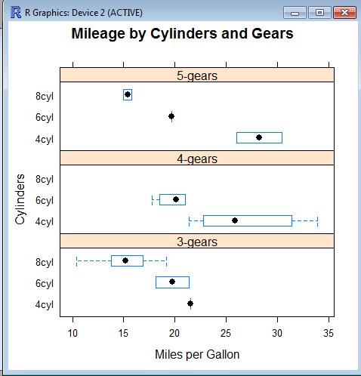
R Programming Course
4.6 Base, Grid & Lattice Graphics - continued

Slide 18
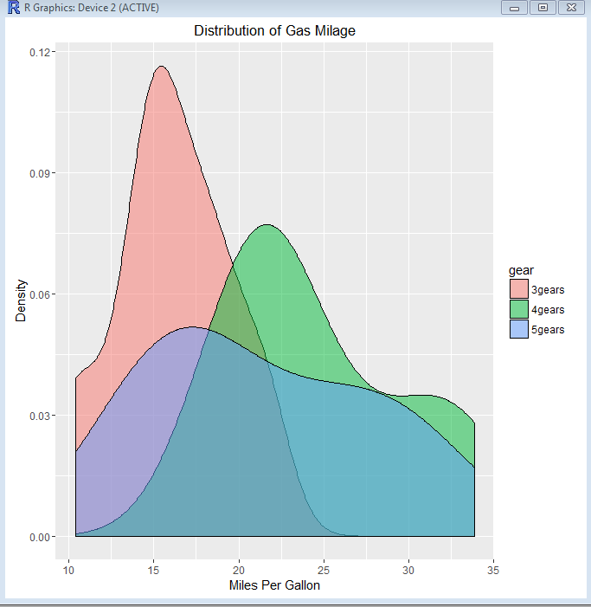
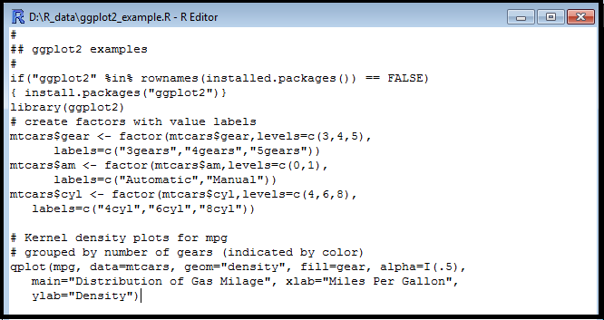
R Programming Course
4.7 Graphics with ggplot2
The package, ggplot2 created by Hadley Wickham offers a powerful graphics language for creating elegant and complex plots.
Its popularity in the R community has exploded in recent years.
Helper function, qplot() (for quick plot) hides much of the complexity when creating standard graphs.

Slide 19
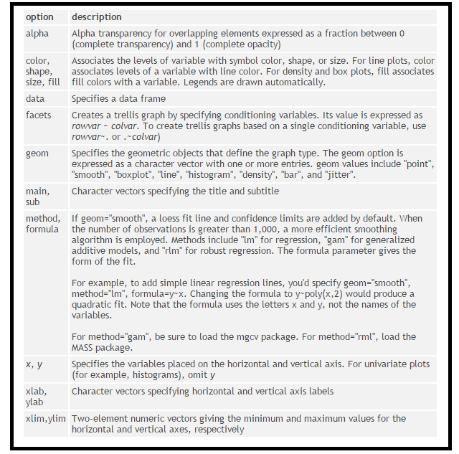
R Programming Course
4.7 Graphics with ggplot2 - continued
qplot(x, y, data=. color= shape=, size=, alpha=,geom=, method=, formula=, facets=, xlim=, ylim=, xlab=, ylab=, main=, sub=)

Slide 20

R Programming Course

Slide 21
R Programming Course
Lab Exercise 1:
The data set mtcars is an in-built in R and contains the data extracted from the 1974 Motor Trend US Magazine, and comprises fuel consumption and 10 aspects of automobile design and performance for 32 automobiles (1973-74) models.
Ref: http://stat.ethz.ch/R-manual/R-devel/library/datasets/html/mtcars.html
Create a scatter plot and regression line using the function lm() for the relationship between mpg and wt of cars in the data set mtcars.
Save the graph as a pdf file in your current working directory in R.

Slide 22
R Programming Course
Lab Exercise 1 - continued:
A scatter plot pairs up values of two quantitative variables in a data set and display them as geometric points inside a Cartesian diagram.
The basic function to create a scatterplot is plot(x,y), where x and y are numeric vectors denoting the (x,y) points to plot. In our example, x is wt (weight) of the car and y is mpg (miles per gallon).
We can generate a linear regression model of the two variables with the lm() function, and then draw a trend line (regression line) with the function abline().

Slide 23
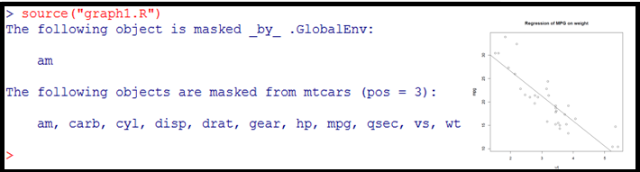
R Programming Course
Lab Exercise 1 - continued:
Run the R code for this exercise “graph1.R” available with you.

Slide 24
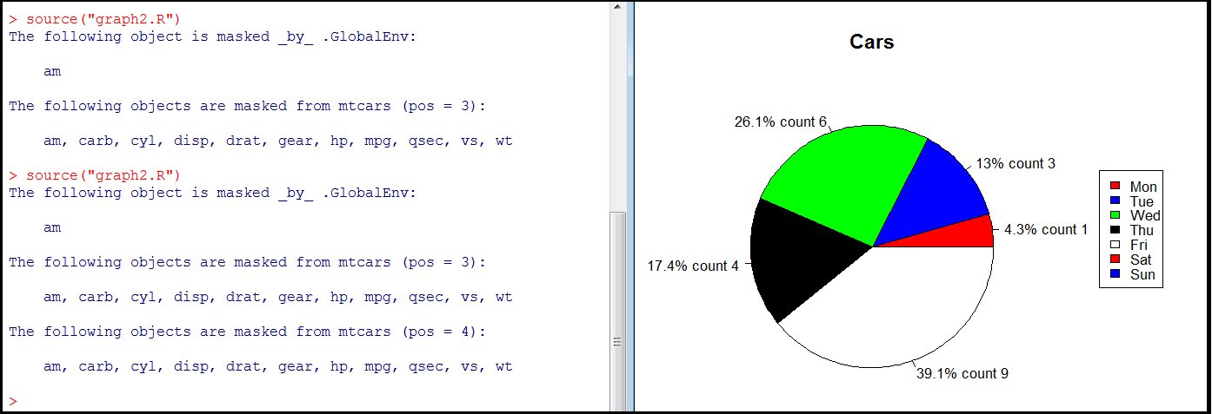
R Programming Course
Lab Exercise 2:
Run the R code “graph2.R” available with you.
Here we draw a pie chart depicting the sale of cars during a week, Monday to Friday.

Slide 25
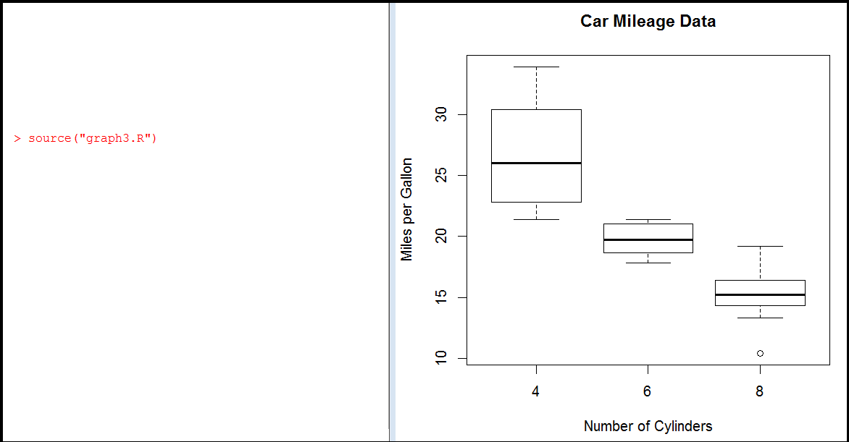
R Programming Course
Lab Exercise 3:
Run the R code “graph3.R” available with you.
Here we draw a boxplot of mpg by gas cylinders.

Slide 26
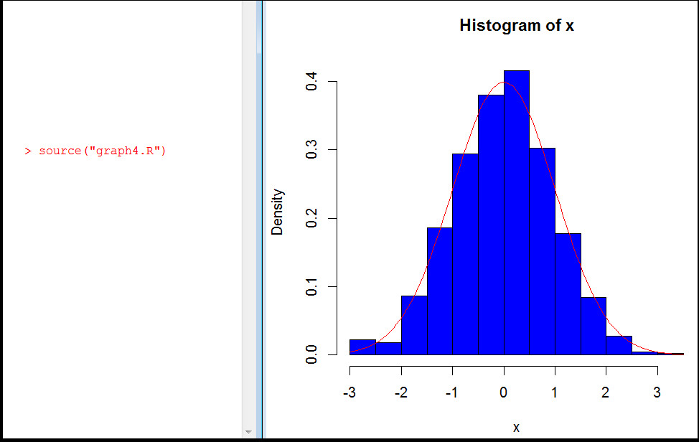
R Programming Course
Lab Exercise 4:
Run the R code “graph4.R” available with you.
Here a normal curve is overlaid on the histogram. Note we have used dnorm() function to get the normal density values. We have used the mean of x and the standard deviation of x to define this particular normal distribution.

Slide 27
R Programming Course
Activity 1:
Read the file “U06_R Graphs_v1.pdf“

